Slide 1
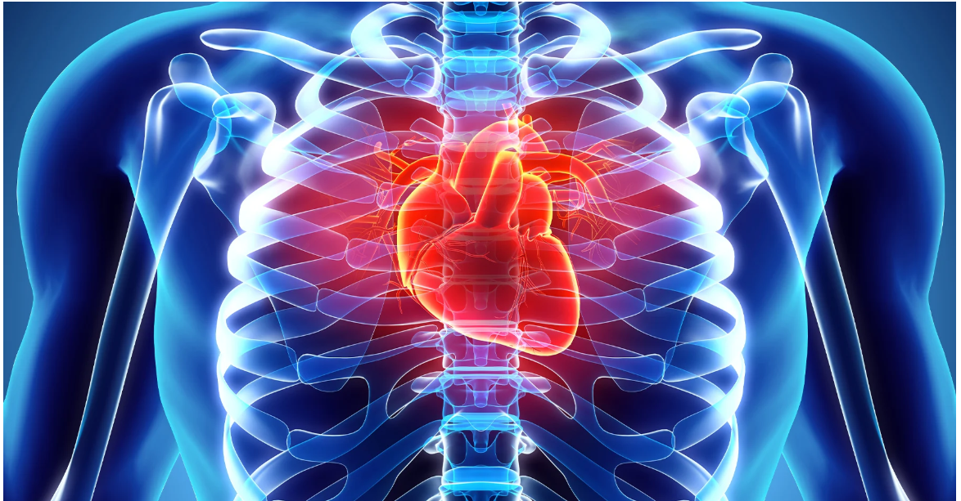
Heart Disease Prediction Using Logistic Regression
Submitted by: Muhammad Ibrahim
Roll No: 24-MS-DS-10
Course: Statistical and Mathematical Methods In Data Science

Slide 2
Introduction
Cardiovascular diseases (CVDs) are a major cause of mortality worldwide.
Early detection is crucial for prevention and timely intervention.
This project applies logistic regression to predict heart disease using clinical data.
The model aims to assist healthcare professionals in making informed decisions.

Slide 3
Scope of Analysis
Dataset: UCI Heart Disease Dataset (303 records, 14 features).
ETL Process: Extract, Transform, Load clinical data.
Model: Logistic Regression trained for classification.
Performance Metrics: Accuracy, Precision, Recall, AUC-ROC.
Objective: Identify key predictors of heart disease.

Slide 4
ETL Process & Data Preprocessing
Extract: UCI Heart Disease Dataset acquired.
Transform: Handled missing values, encoded categorical variables, scaled numerical features.
Load: Processed data fed into logistic regression model.
Key Features: Age, Sex, Cholesterol, Thalach, Oldpeak.

Slide 5
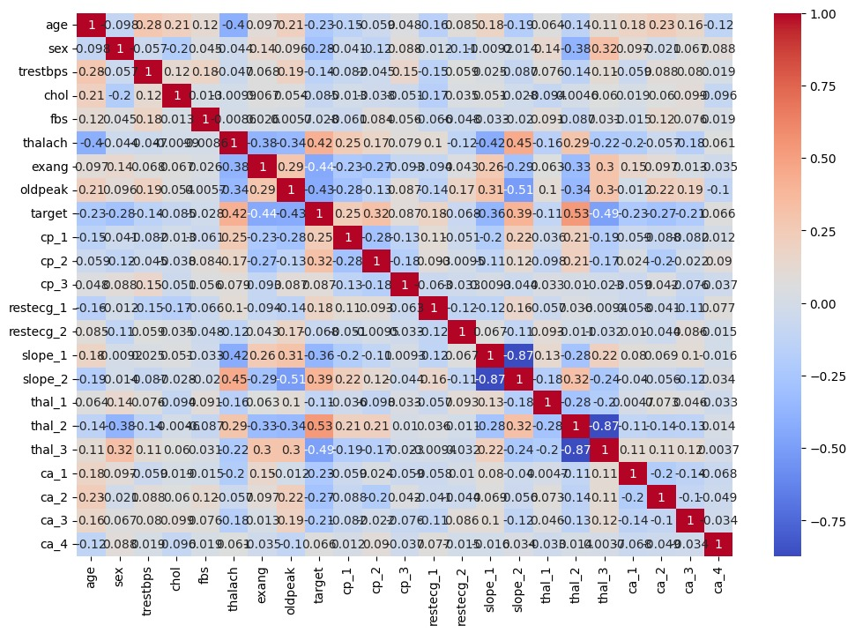
Correlation Heatmap
Correlation Heatmap of Clinical Features

Slide 6
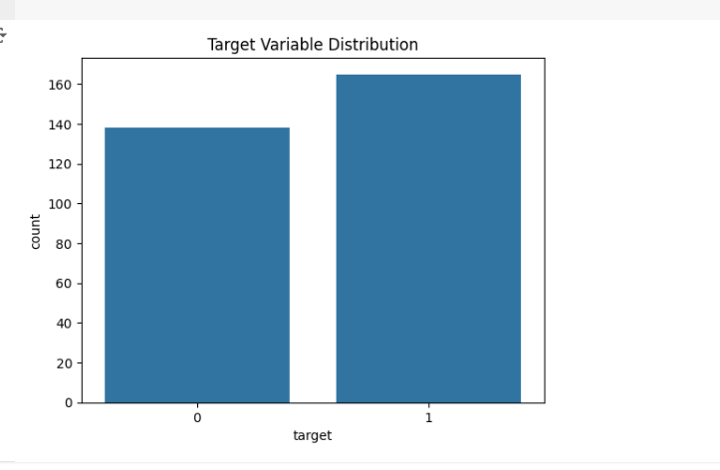
Target Variable Distribution
Distribution of Target Variable Presence of Heart Disease

Slide 7
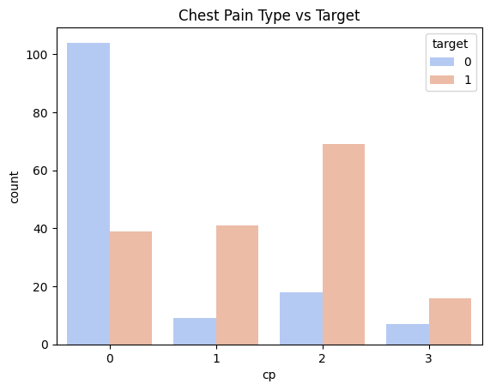
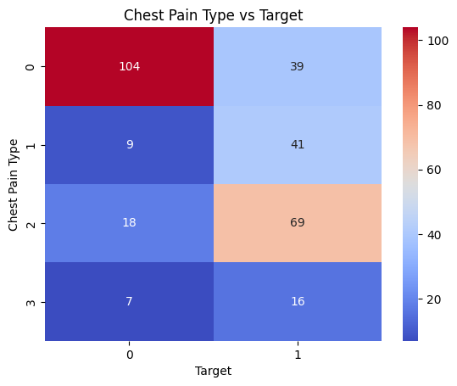
Categorical Feature Distributions
Chest Pain Type (cp) Distribution by Target Variable

Slide 8
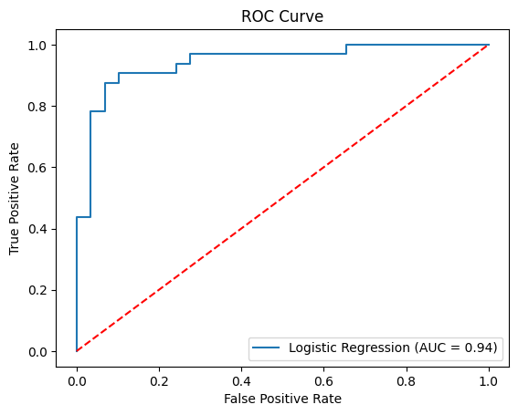
Logistic Regression Model Performance
ROC Curve for Logistic Regression Model

Slide 9
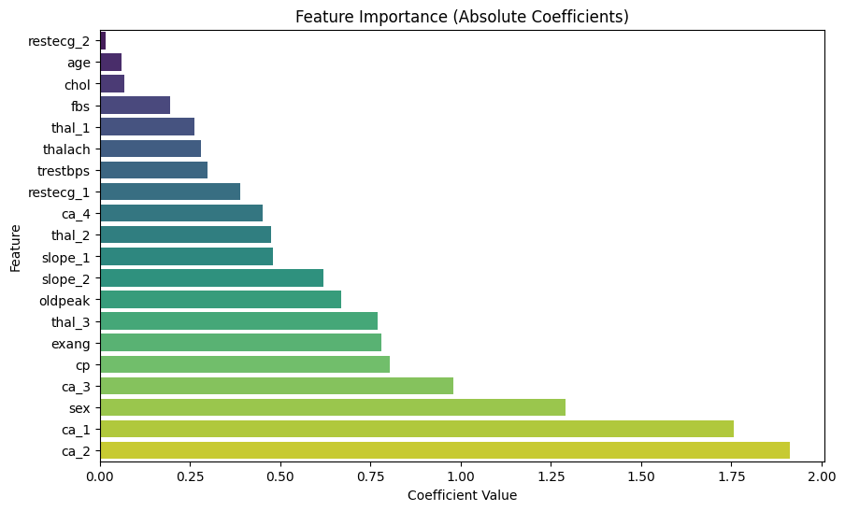
Feature Importance

Slide 10
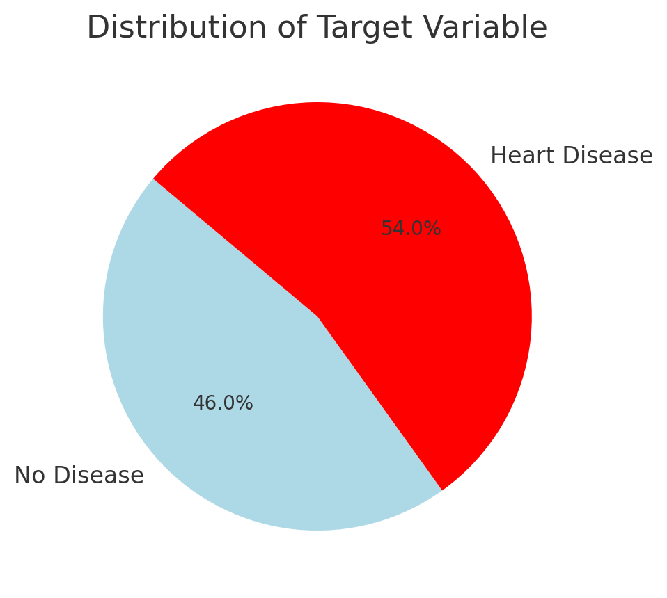
Model Performance
Accuracy: 90.16%
Precision: 93.33%
Recall: 87.50%
F1 Score: 90.32%
ROC-AUC Score: 94.18%
Feature Importance: Thalach, cp_3, ca_2 were the most influential predictors.

Slide 11
Key Insights & Future Scope
Key Insights:
halach (Max Heart Rate) and Oldpeak are strong indicators.
Logistic Regression is effective in binary classification problems.
Future Scope:
Use advanced models like Random Forest, XGBoost.
Deploy a real-time heart disease prediction system.
Integrate more clinical and lifestyle features.

Slide 12
Conclusion
Logistic Regression successfully predicts heart disease with high accuracy.
Key predictors include Thalach, Chest Pain Type, and Oldpeak.
Future improvements involve adding more features and using advanced models.
This research can aid in early detection and intervention of cardiovascular diseases.

